Slide 1
Building Enterprise Java Applications with Spring
Day 5
Magdalene Lim,
Desmond Lee,
Kavitha Muniraj
Republic Polytechnic

Slide 2
Welcome and admin matters
Please ensure that:
Attendance has been captured (via QR code scanning)
A learning laptop is with you
Good view on the display
Course materials are also available at: https://github.com/kavithamuniraj/CETSpringBootAY2022
Notes:
https://en.wikipedia.org/wiki/QR_code_payment

Slide 3
Admin matters
A tidy/clean laptop is a good laptop for learning
Files created on the laptop will linger on. To prevent this:
Create a folder in the "Documents" location for this workshop
E.g. “SpringBoot-Alan" or “SpringBoot-PeterPan“
All user created files to be placed in this folder
Delete that folder after the course
Notes:
https://en.wikipedia.org/wiki/QR_code_payment

Slide 4



Trainers
Magdalene Lim
Senior Lecturer
School of Infocomm
Magdalene_lim@rp.edu.sg
Desmond Lee
Associate Lecturer
School of Infocomm
DESMOND_LEE@myrp.edu.sg
Kavitha Muniraj
Lecturer
School of Infocomm
Kavitha_muniraj2@rp.edu.sg
Notes:
https://en.wikipedia.org/wiki/QR_code_payment

Slide 5
Schedule
Time | Agenda
9:00 am - 9:15 am | Welcome and admin matters
9:15 am – 10:30 am | Validation
10:30 am – 10:45 am | Break
10:45 am – 12:30 pm | Front end Validation
12:30 pm – 1:30 pm | Lunch
1:30 pm – 3:15 pm | Backend Validation
3:15 pm – 3:30 pm | Break
3:30 pm – 4:45 pm | Lab Session – help with errors or clarification about codes
4:45 pm – 5:00 pm | Wrap up, Q&A
Notes:
https://en.wikipedia.org/wiki/QR_code_payment

Slide 6
Topics Covered in this course
Validation
Front end Validation at the Forms
Backend Validation using the Model, Controller and View
Notes:
https://en.wikipedia.org/wiki/QR_code_payment

Slide 7

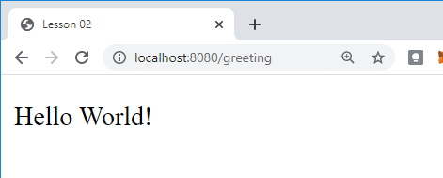
RECALL - REST API – Client Server Model
1. The client makes a request
http://localhost:8080/greeting
2. The web server receives the request and passes it to the controller.
3. GreetingController.java processes request and returns response (View)
greeting.html
(View)
4. The client displays the response received.
Notes:
What web server are we using?

Slide 8
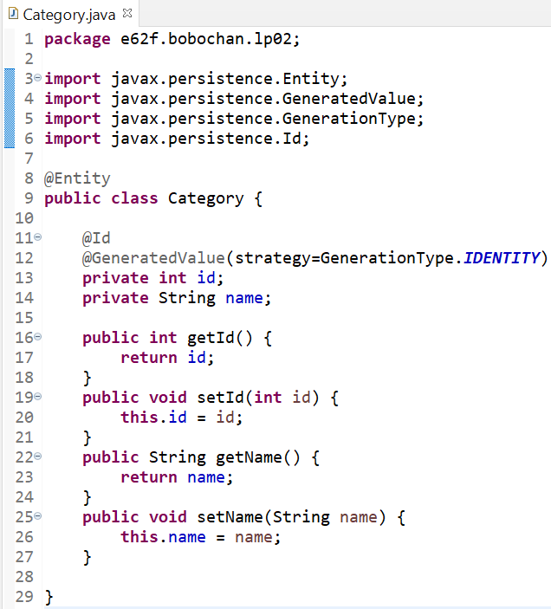
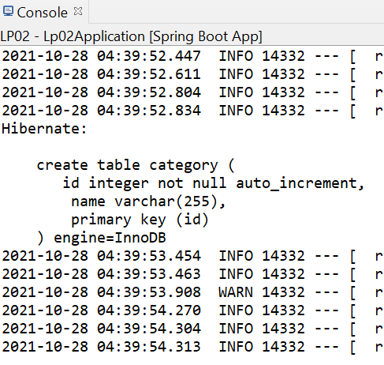
RECALL - JPA-Hibernate-MySQL
Springboot application
Spring Data JPA
Hibernate ORM Framework
MySQL DB

Slide 9
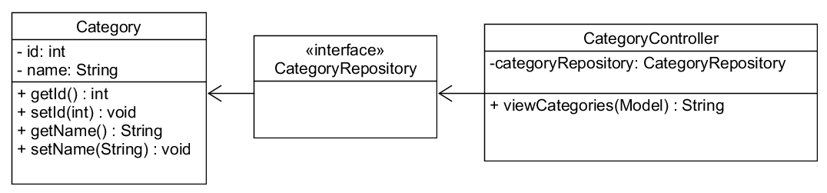
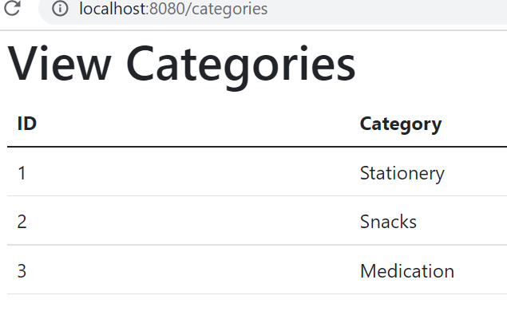
RECALL - Viewing a list of categories

Slide 10
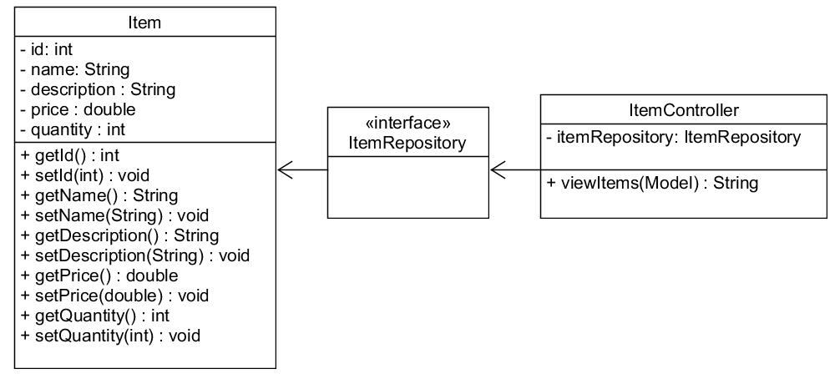
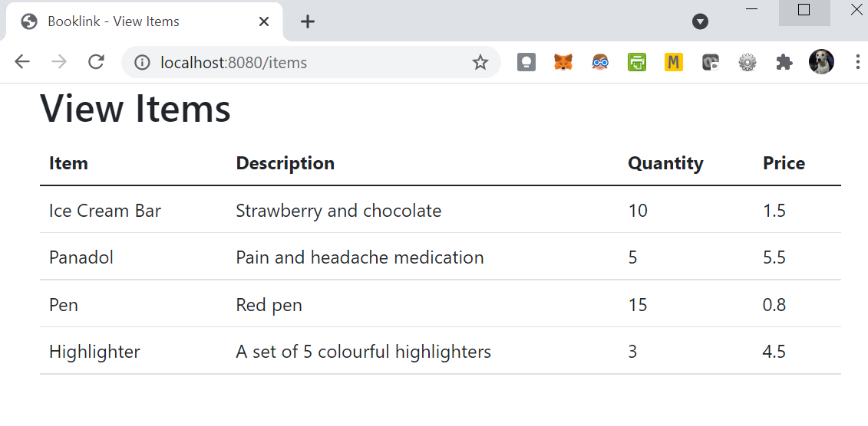
RECALL - Viewing a list of items

Slide 11
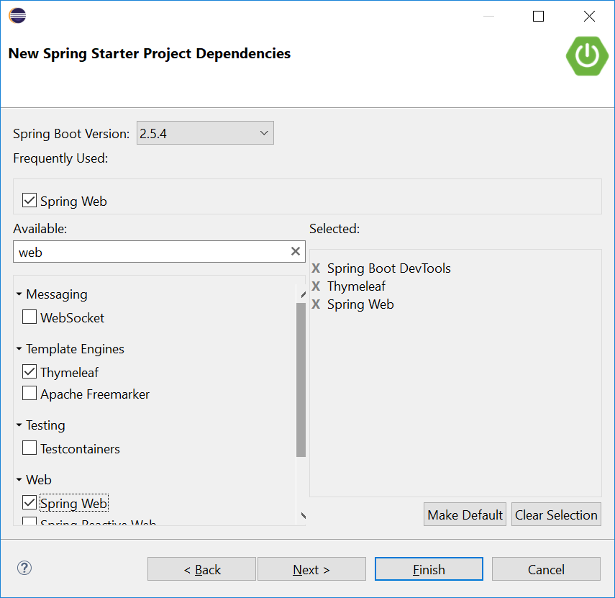
RECALL - Thymeleaf
Recall that in our Springboot projects, we included a dependency, Thymeleaf.
Thymeleaf is a server-side Java template engine for both web and standalone environments.
It is a view technology that performs server-side rendering of HTML.
We use variable expressions ${…} bind the data from the template context(model) into the resulting html(view).

Slide 12
RECALL: Thymeleaf attributes
th:each - used for iteration
th:text - evaluates its variable expression and sets the result of this as the body of the tag it is in
As we progress in the lessons, we will be using more types of attributes. You can find the full list here:
https://www.thymeleaf.org/doc/tutorials/3.0/usingthymeleaf.html#setting-attribute-values

Slide 13
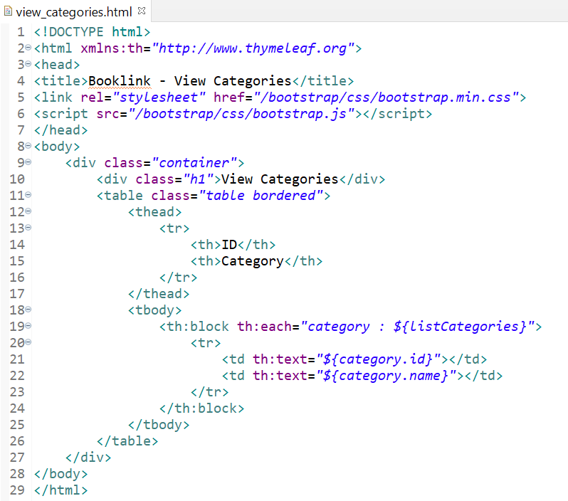
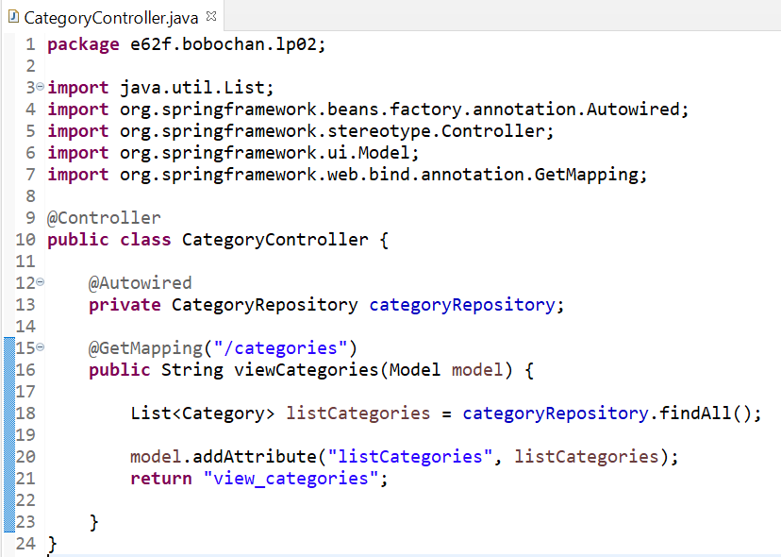
RECALL –View Categories
We used the variable expression ${…} to retrieve the information stored in the model attributes.

Slide 14
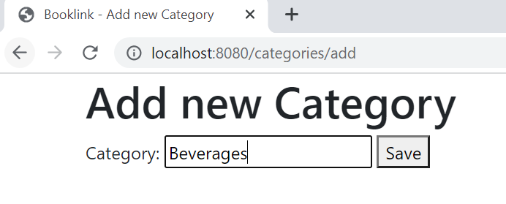
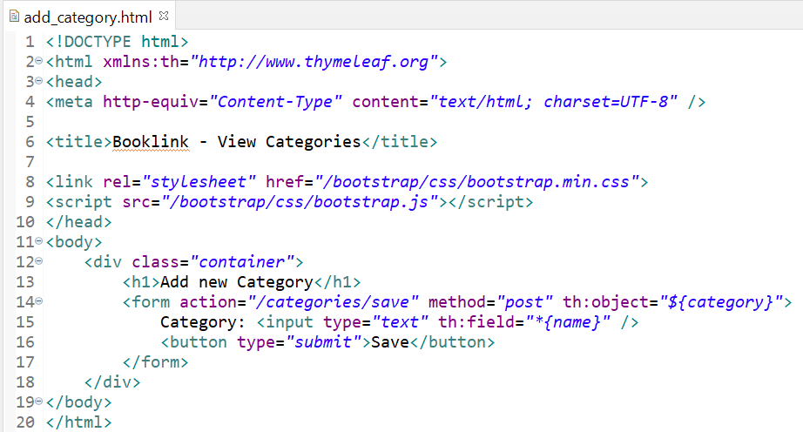
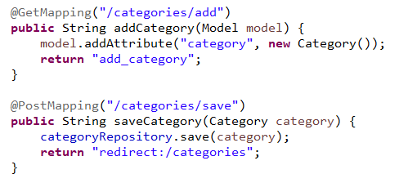
RECALL: Add a new Category using Forms
1. When the Save button is clicked, the data will be sent via the POST method to the location set in the action attribute of the form
2. The details will be passed as a category object to the method, saveCategory.
3. The category object containing the new information will be saved to the database using the save method from categoryRepository object.
Recall that the JpaRepository helps us with CRUD. No additional SQL is required to insert the data into the database.
4. After saving the new category, the page is then redirected to http://localhost:8080/categories/

Slide 15
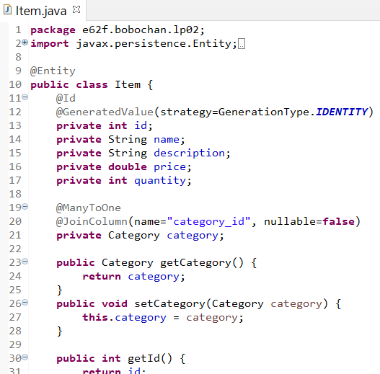
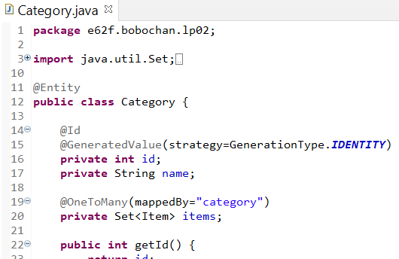
RECALL Joining Table – Category and Item
@JoinColumn defines the column to join the category and item tables.
The @OneToMany and @ManyToOne describes the relationship between the 2 entities.
A Set is a collection that does not contain any duplicate objects. In this case, items will not contain any duplicate Item objects. The @OneToMany annotation will be applied to items.
Category object added as a field here. The annotations @ManyToOne and @JoinColumn above will be applied to category.
mappedBy indicates link to category object in the Item class.

Slide 16
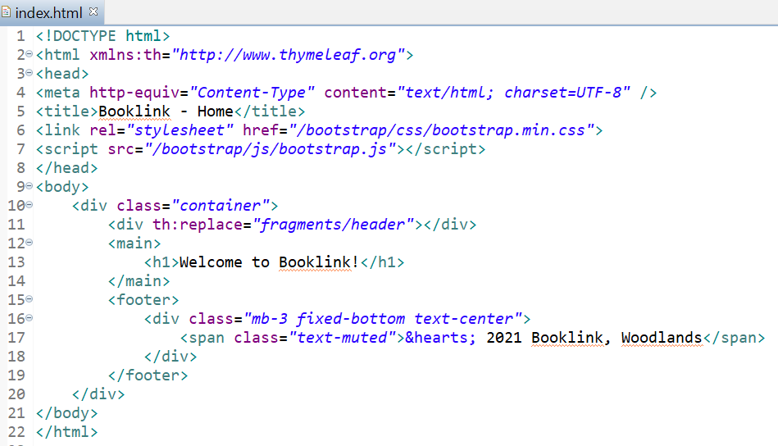
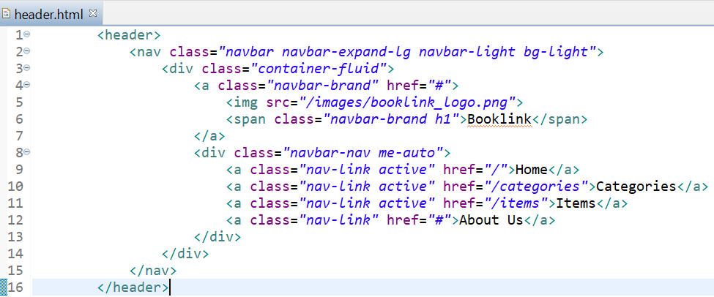
RECALL - Creating header fragment
From index.html, copy the header HTML code and paste it inside header.html.
In index.html, replace the header code with the reference to the fragment as shown.
Note that the mappings here are handled automatically by Thymeleaf.
We do not need to create the mappings ourselves in the controllers.

Slide 17
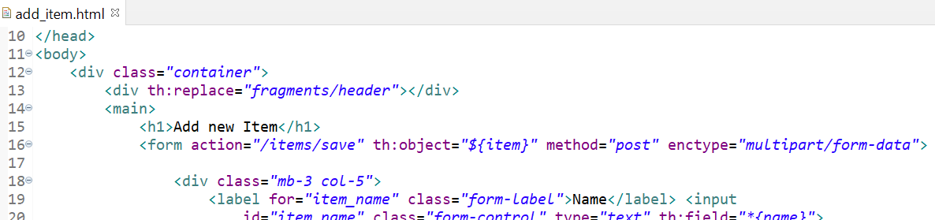
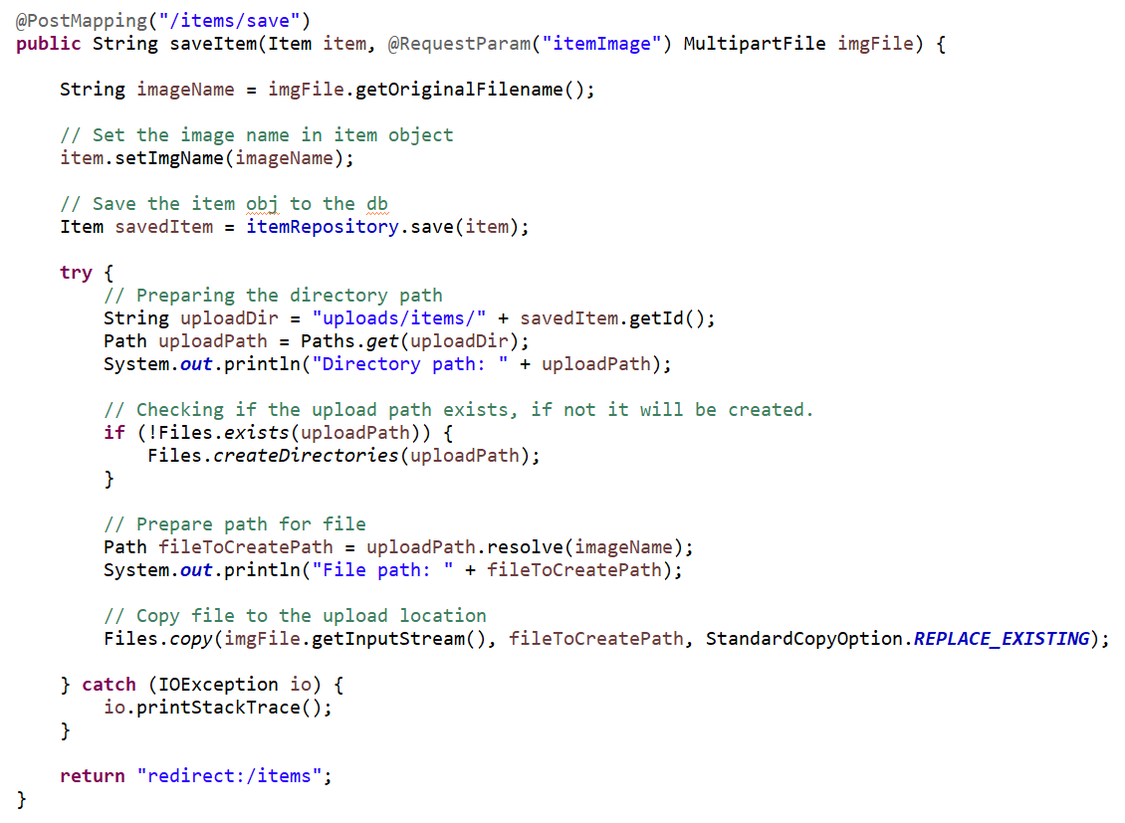
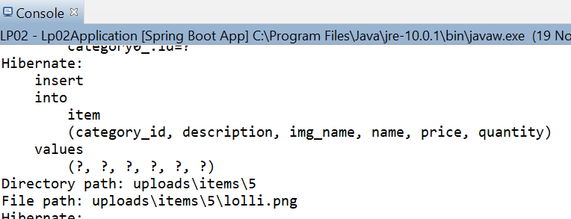
RECALL - Uploading Images
1. The enctype must be set to multipart/form-data if we have any input of type file.
2. Input name and requested param name must match
3. The id here is 5 as we already have 4 items added previously. The id may be different for you depending on how many items you added before this exercise.

Slide 18
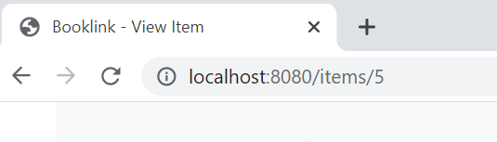
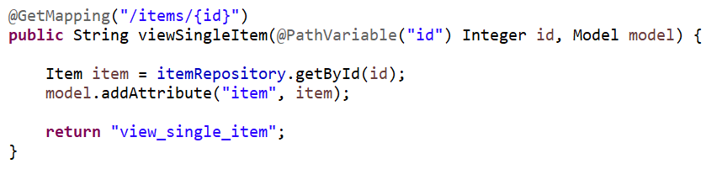
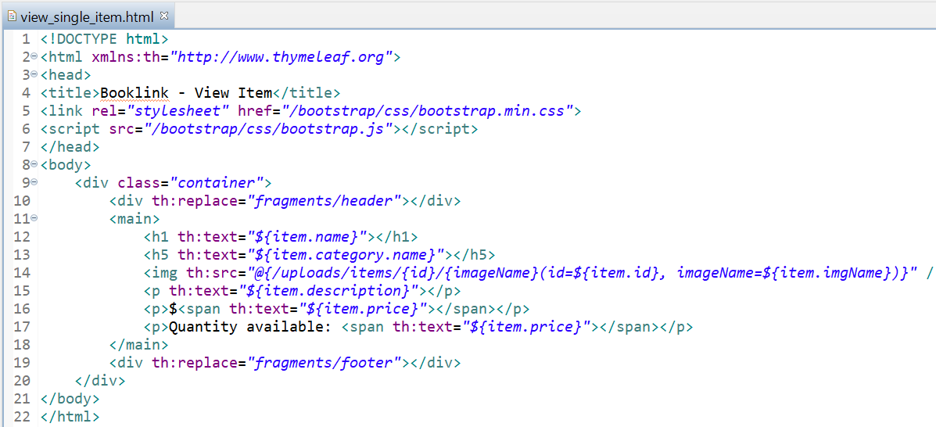
RECALL - View Single Item
1. The id is passed to the mapping which is then passed to the method as a PathVariable.
2. The getById method uses the id to retrieve the item object.
3. The @{..} is a thymeleaf link expression, used to evaluate expressions in a url.
Here we passed 2 parameters separated by , .

Slide 19
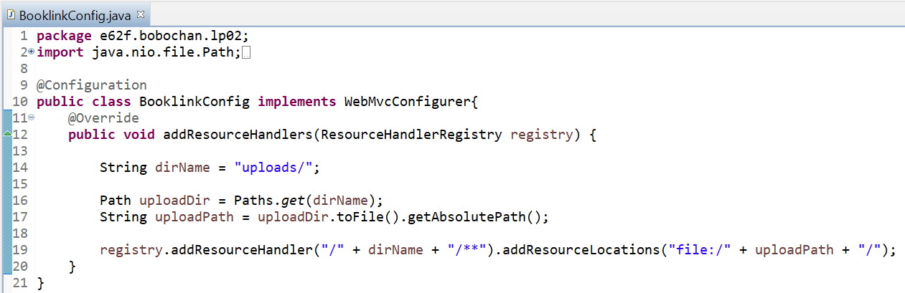
RECALL -Set Image Path using WebMVCConfigurer
1. @Configuration annotation is used here to indicate to Spring that this class should be instantiated and any dependencies should be injected
2. The WebMvcConfigurer is implemented here so that we can override the addResourceHandlers method to customize it for our purpose.
3. Stores registrations of resource handlers for serving static resources such as images, css files and others through Spring MVC. Resources can be served out of locations under web application root, from the classpath, and others.
Without adding a resource handler to the registry, we will not be able to access the resource, which resulted in our image not appearing on the website when we browsed to it earlier.
4. Adds a resource handler to serve static resources. The handler is invoked for requests that match one of the specified URL path patterns.
5. Adds a resource location from which to serve the files uploaded. The location must point to a valid directory

Slide 20
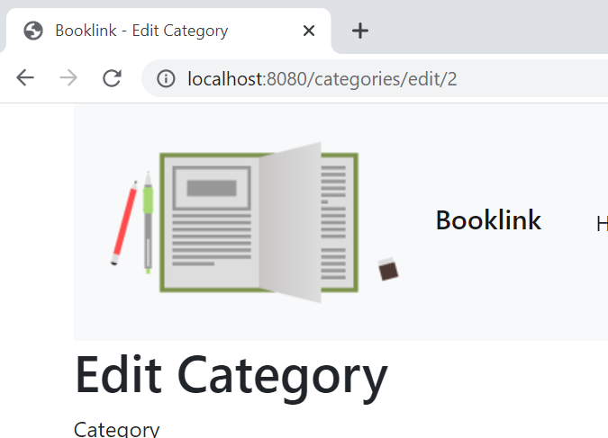
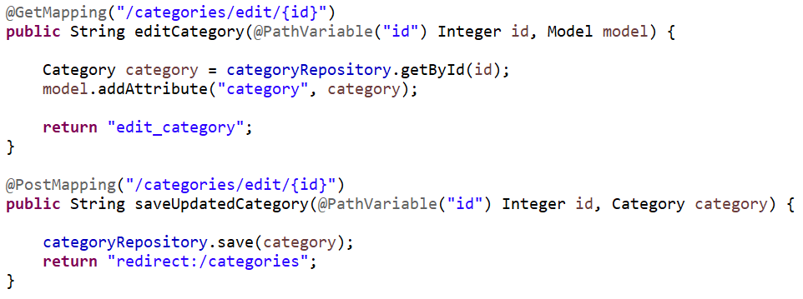
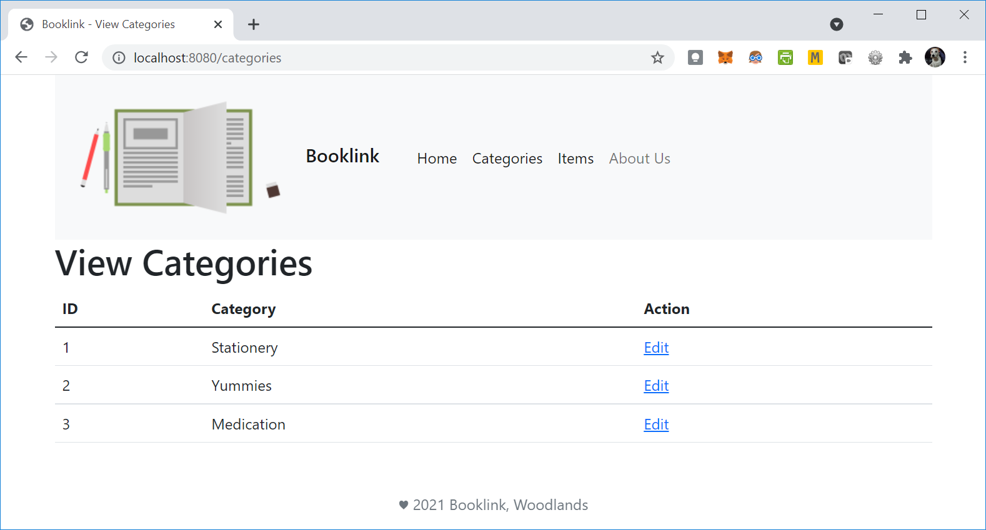
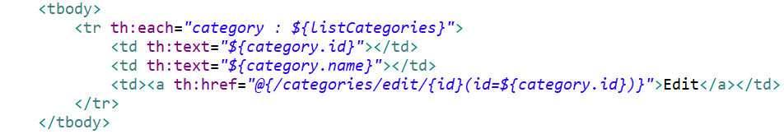
RECALL - Update Category
The @PathVariable is used to handle template variables in the request URI mapping, in this case, the item id. This will then be set as a method parameter, in this case also named id.
CategoryController.java
As we use the thymeleaf link expression to help us include parameters, we pre-fix the href with th: to indicate this to be processed by thymeleaf.
view_categories.html

Slide 21
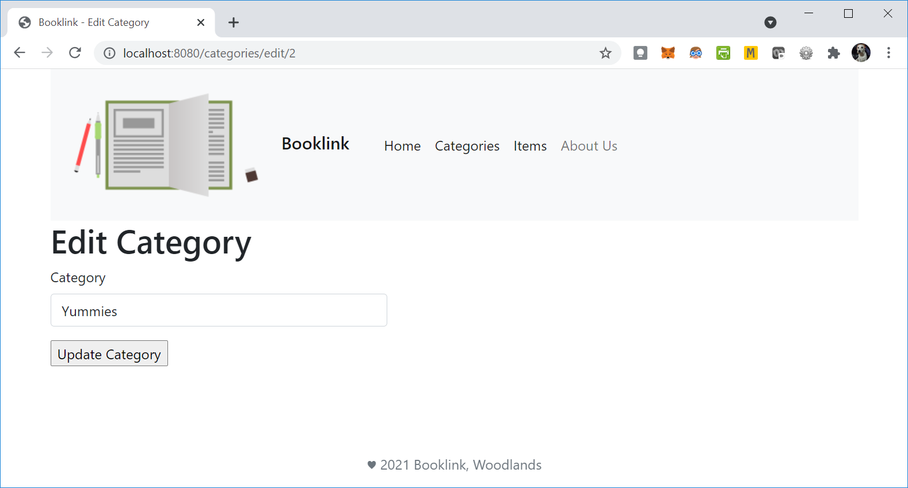
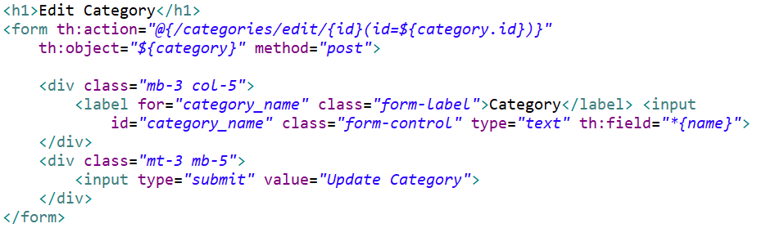
RECALL - Update Category
CategoryController.java
edit_category.html
When the Update Category button is clicked, the updated category will be sent to the path in the action attribute of the form, which will map to @PostMapping(“/categories/edit/{id}”)

Slide 22
Create LP03 Project
Notes:
Similar to lesson 02 instructions

Slide 23
Exercise 1 – Create LP03 project
Create a new springboot project named LP03.
Note that we will need the following dependencies
Spring Boot DevTools
Spring Web
Thymeleaf
Spring Data JPA
MySQL Driver
Refer to Day 1 Springboot_Project_Setup_Guide.pptx for details on setting up the springboot project.
Notes:
Validation and Spring security to be added later as it will autoset up basic security

Slide 24
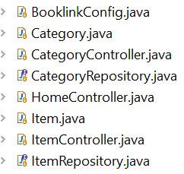
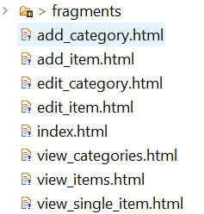
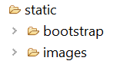
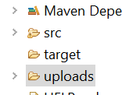
Exercise 1 – Copying LP02 files
The code for LP02 has been provided to you in the resources folder. Copy the files provided into the appropriate locations in LP03.
Note: You may also copy your own code from LP02 into LP03.
Remember to copy the uploads folder as well if you are copying your own LP02
Notes:
Students are provided with the files in case their code from LP02 was incomplete.
They should check the package names to make sure it matches with LP03 package names.

Slide 25
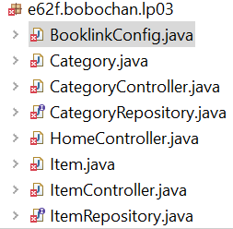
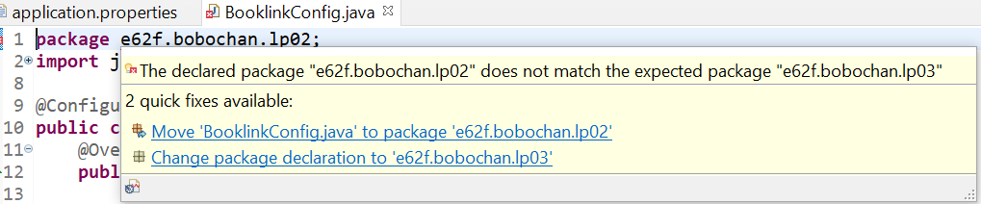
Exercise 1 – Copying LP02 files
When pasting the code into the appropriate locations from LP02 to LP03, you will encounter some errors due to the package location.
Mouse over the error in line 1 and select “Change package declaration to …”
Remember to save your code.

Slide 26
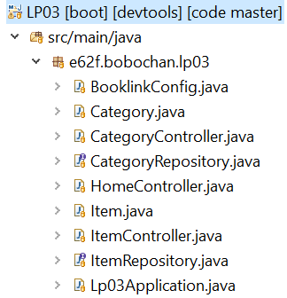
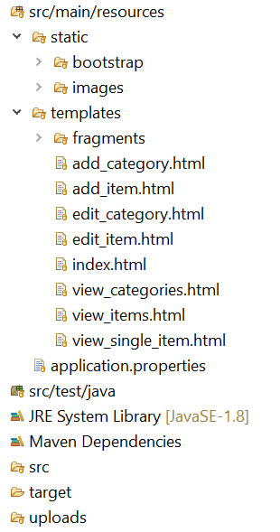
Exercise 1– Copying LP02 files
You should see the project structure similar to the image here.
You may continue using cet as your database.
Run and test that your application works
Notes:
There may be issues with the config file, ask students to see comments in BooklinkConfig.java

Slide 27
Booklink Members

Slide 28
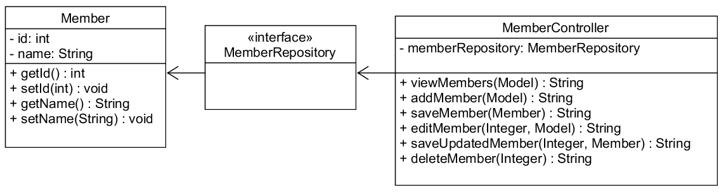
Exercise 2 – Booklink Members
Create the classes based on the class diagram below.
Notes:
Give students time to work on this on their on before reviewing at end of first meeting.

Slide 29
Exercise 2 – Booklink Members
In MemberController, include the mappings and methods required to:
Add a new member
View a list of all members
Edit a member’s detail
Delete a member
Notes:
Give students time to work on this on their on before reviewing at end of first meeting.

Slide 30

Exercise 2: Header Fragment to include Members
Create the following views:
add_member.html – To add new members
view_members.html – To view a list of all members
edit_member.html – To edit a member’s details
Update the header fragment to include a link to a list of members:
Notes:
Give students time to work on this on their on before reviewing at end of first meeting.

Slide 31
Validation

Slide 32
Validation
Validation is the process of ensuring that input is checked based on the requirements or constraints of that particular input.
For example - in a web form, we may have certain fields that must be entered before the form can be submitted.
Therefore, empty input would be considered as invalid.

Slide 33
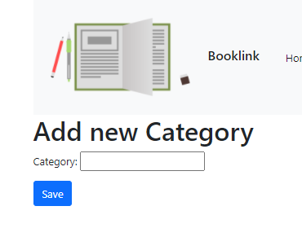
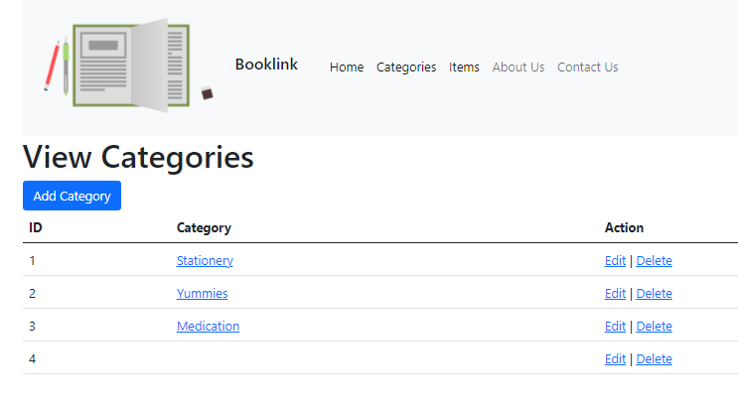
Invalid Input – Empty values
Attempting to save an empty category is possible at this point in our Booklink website.
Notes:
Get students to try

Slide 34

BREAK

Slide 35
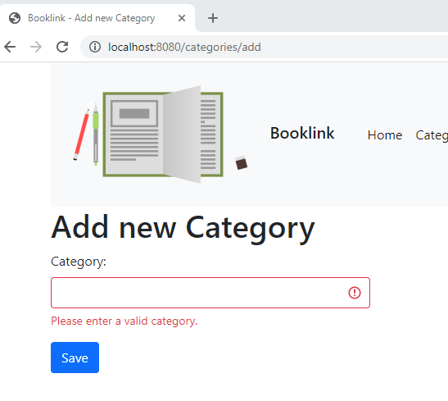
Invalid Input – Empty values
To stop users from entering empty values into our system, we need to apply some form of validation to our forms.
There are two parts to validation of input
Front-end or client-side
Back-end or server-side

Slide 36
Front-end Validation

Slide 37
Front-end validation - JavaScript
JavaScript(JS) is a scripting or programming language that allows you to implement dynamic features on a webpage.
Most responsive or interactive components that you see on a webpage such as instant updates or checks, games, maps, etc, will likely involve some form of JS.
You can use plain JS or use one of the many JavaScript frameworks out there that provide features to help you to build a more interactive website.
Notes:
Students did some basic Javascript in C369

Slide 38
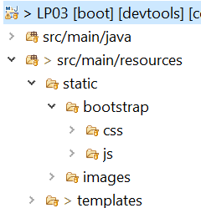
Front-end validation - JavaScript
Besides being a CSS framework, Bootstrap 5 is also able to work with plain JS and has dropped dependency on jQuery(A JS framework).
We will use some classes from bootstrap to style feedback
Take a look at the bootstrap folder you have in your project setup, you should see a js folder.
Check that your path to the js folder is correct in your template files.
Notes:
Mention to students that if they are using lower versions of bootstrap, then they will still need jQuery for most interactive features.

Slide 39
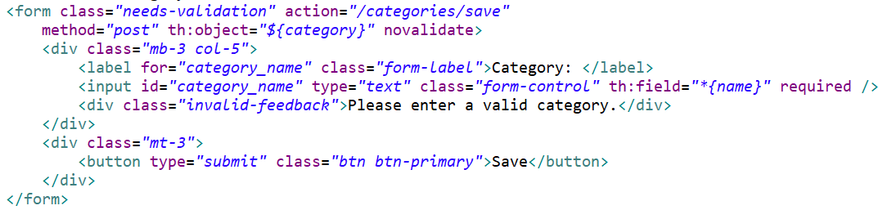
Exercise 3 – Front-end Validation with JS and Bootstrap
Modify the form in add_category.html with the code highlighted
Notes:
https://getbootstrap.com/docs/5.0/forms/validation/
For custom Bootstrap form validation messages, you’ll need to add the novalidate boolean attribute to your <form>. This disables the browser default feedback tooltips, but still provides access to the form validation APIs in JavaScript.

Slide 40
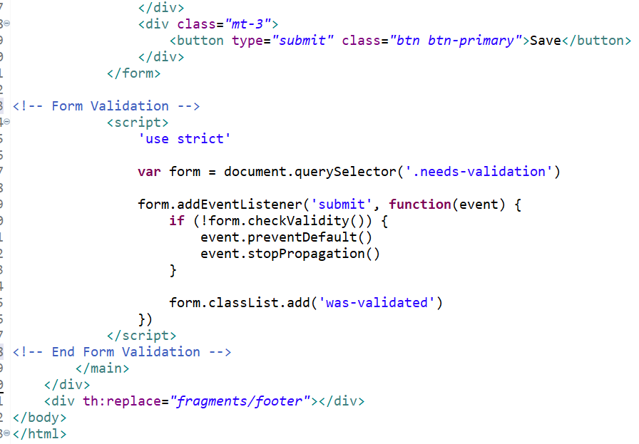
Exercise 3
Include the JS for validating empty fields as shown.

Slide 41
Exercise 3
Save* and test the add new category feature by attempting to submit an empty value.
Paste the code in your worksheet.
*Whenever changes are made to HTML files, you should refresh the page to see the updates.

Slide 42
How it works
The querySelector is used to select the element with the stated class, in this case “needs-validation”
The checkValidity method checks whether the form has any constraints and whether it satisfies them.
If the required constraint fails, the form will not be allowed to continue to submit and the div with the “invalid-feedback” class will be displayed.
For custom Bootstrap form validation messages, you’ll need to add the novalidate boolean attribute to your <form>.
This disables the browser default feedback tooltips, but still provides access to the form validation APIs in JavaScript.

Slide 43
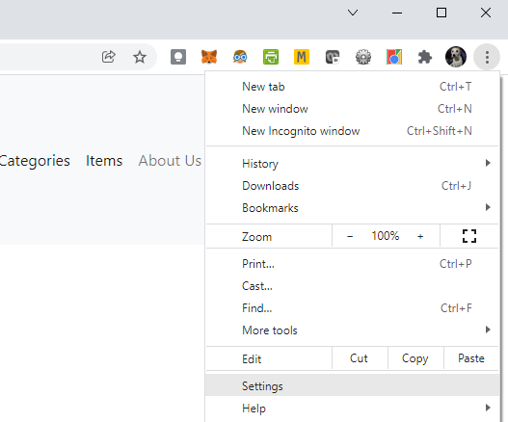
Exercise 4 – Disabling JS in a web browser
In chrome, turn off JavaScript by going to the 3 dots and select Settings

Slide 44
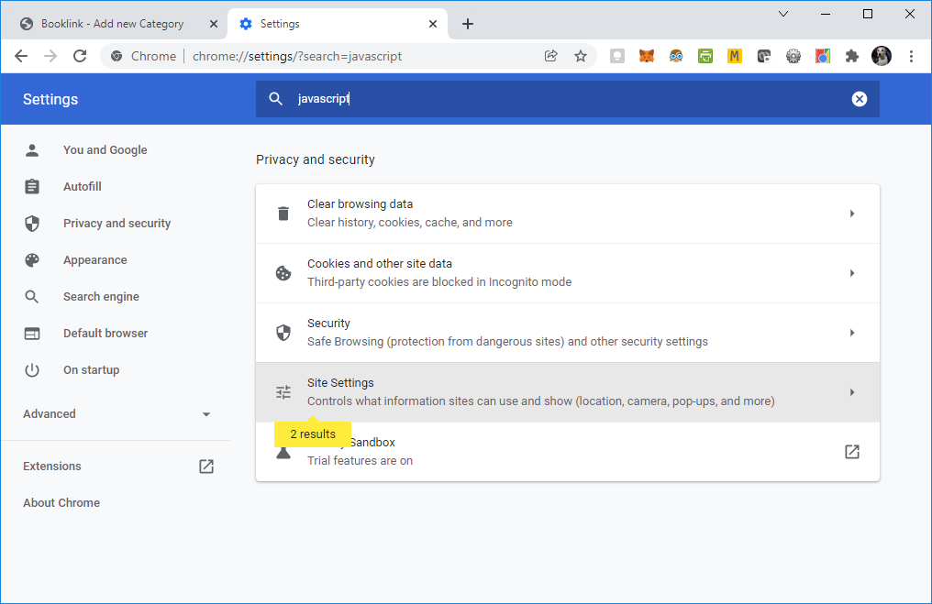
Exercise 4 – Disabling JS in a web browser
Type javascript in the search and click on Site Settings

Slide 45
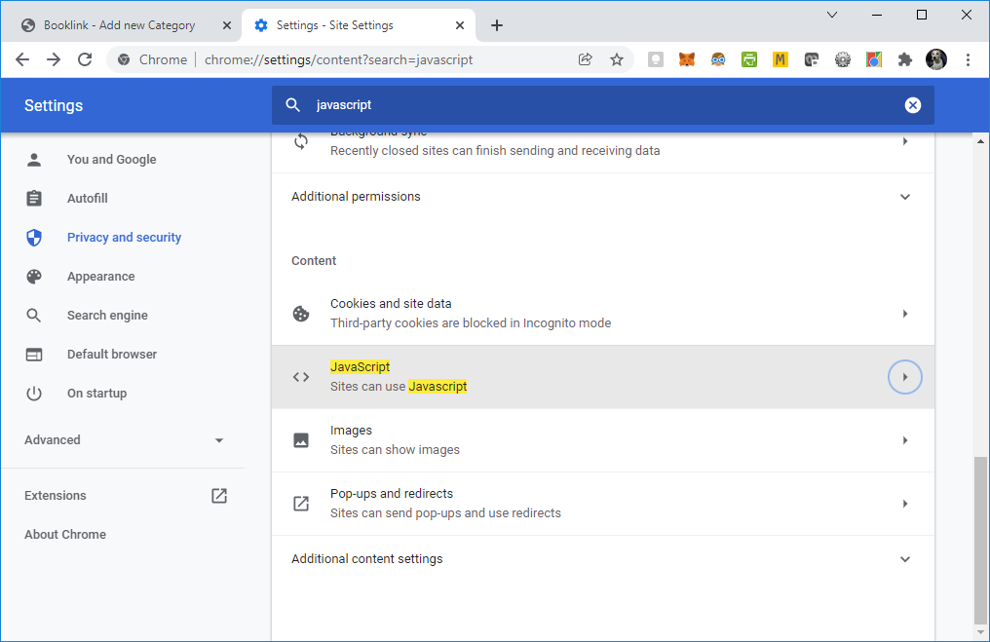
Exercise 4 – Disabling JS in a web browser
Scroll down and click JavaScript

Slide 46
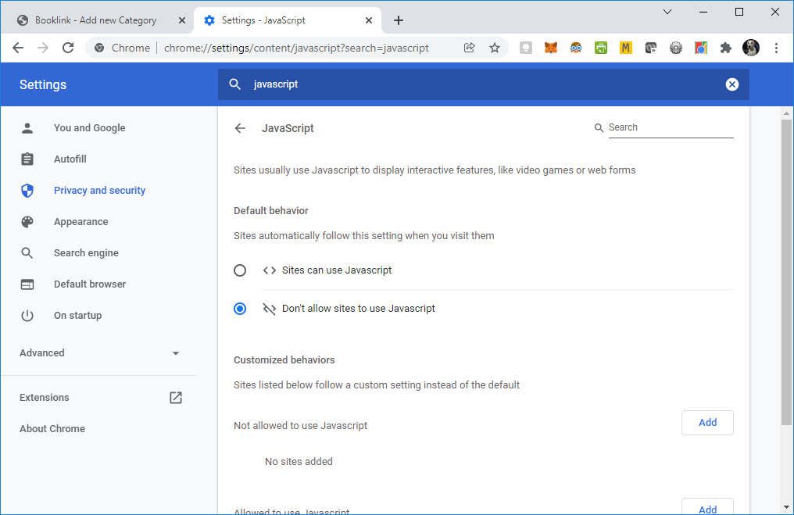
Exercise 4 – Disabling JS in a web browser
Select Don’t allow sites to use JavaScript

Slide 47

Exercise 4 – Disabling JS in a web browser
Now test the add category feature in booklink again.
Write down your observations in the worksheet.
Why do you think users may turn off JavaScript?

Slide 48
Exercise 4 – Disabling JS in a web browser
Write down your observations in the worksheet.
Empty category values can be submitted again into the Booklink website.
The Javascript code we wrote earlier appears to have been ignored by the web browser.
What are some possible reasons that users may turn off JavaScript?
Possible security risk as some exploits use JavaScript
Privacy issues, to prevent tracking of user activity
To turn off advertisements
Note: JavaScript is widely used these days and it is not practical to switch it off nowadays as many sites use it. (E.g. try searching for something on google with JavaScript switched off.)

Slide 49

LUNCH

Slide 50
Back-end Validation

Slide 51
Back-end Validation
Back-end validations are validations that are done on the server side.
What you validate on the back-end, should be the same as what you validate on the front-end.
There may be times when JavaScript may be turned off by a user for various reasons.

Slide 52
Exercise 5 – Front-end validation disabled
What happens if front-end validation for a web form is disabled?

Slide 53
Exercise 5 – Front-end validation disabled
What happens if front-end validation for a web form is disabled?
If front-end validation is disabled and there is no back-end validation, empty values or invalid data could be submitted into the database.
In the worst case scenario, potentially malicious code could be injected into the system.

Slide 54
Dependency - Validation
Spring Boot provides validation support as well with the Validation dependency.
Recall when creating a new project, we select the dependencies we think we will need for the new project.
However there may be times that we will need to include additional dependencies with an existing project.
We will include the Validation dependency via the pom.xml file.

Slide 55
Exercise 6 – Adding Validation dependency in POM
We will include the Validation dependency in the pom.xml file.
Copy the dependency details here and paste into pom.xml:
<dependency>
<groupId>org.springframework.boot</groupId>
<artifactId>spring-boot-starter-validation</artifactId>
</dependency>

Slide 56
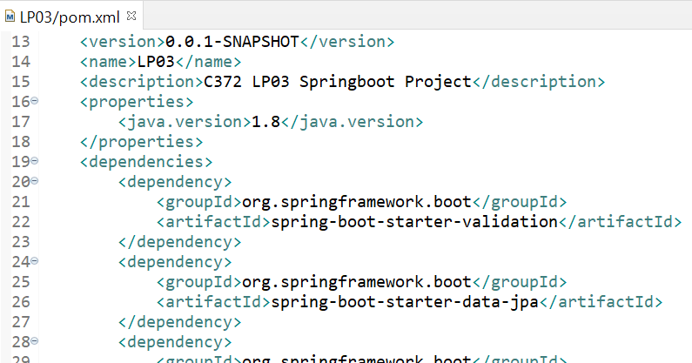
Exercise 6 – Adding Validation dependency in POM
Your pom.xml should look like below.
Save pom.xml and the Springboot project will automatically* load the required libraries.
*Ensure that you are connected to the internet
Notes:
This is another way of adding dependencies other than adding them at the beginning of the project. Students can check the Maven Depencies folder to see if the validation dependency has been included.

Slide 57

Exercise 6 – Validating required input
Modify the Category class to include the annotations @NotNull and @NotEmpty as shown.
The imports should be from javax.validation.constraints
What is the difference between @NotNull and @NotEmpty?
Notes:
Get students to post responses in MS Teams

Slide 58
Exercise 6 – Validating required input
Try adding an empty category again.
Write down your observations in your worksheet.
Notes:
Get students to post responses in MS Teams

Slide 59
Exercise 6 – Validating required input
Try adding an empty category again.
Write down your observations in your worksheet.
A constraint violation error gets thrown. The category name is not added to the database. This is with JavaScript switched off in chrome.

Slide 60

Handling errors
You would have gotten the whitelabel error page as shown with the relevant error message

Slide 61

Handling errors
The empty value is not added, however the user is thrown to an error page which is not very user-friendly.
If a user attempts to save an empty value, the empty value should not be saved into the database, and the user should be prompted to enter a valid value. (Similar to if JavaScript was switched on)

Slide 62

Exercise 7 – Handling errors
Modify the saveCategory method in CategoryController to include the code as shown
Test the add new category feature again.
Paste your code and write down your observations in the worksheet.
Notes:
Get students to post responses in MS Teams

Slide 63
Exercise 7 – Handling errors
Paste your code and write down your observations in the worksheet.
When attempting to add an empty category, there is no longer an error page thrown, instead we are again shown the add_category.html page.
It can be a bit confusing as it looks like nothing happened as there is no message.

Slide 64
Providing user feedback
At this point, the add new category feature does not add empty values, and does not throw an ugly error page, but it does not tell the user what happened either.
In general, we should provide feedback to users whenever some action has taken place, such as adding, updating, or removing a record.

Slide 65

Exercise 8 – Providing user feedback
Modify add_category.html to include the line shown

Slide 66
Exercise 8 – Providing user feedback
Test the add new category feature and write down your observations in the worksheet.
Notes:
Get students to post responses in MS Teams

Slide 67
Exercise 8 – Providing user feedback
Test the add new category feature and write down your observations in the worksheet.
We are now able to see the error message when we attempt to submit an empty category value.

Slide 68
How it works
Thymeleaf allows us to display errors as well.
th:if checks the #fields.hasErrors(...) function, which receives the field expression as a parameter (name), and returns a boolean telling whether any validation errors exist for that field.
th:errors is a specialized attribute which builds a list with all the errors for the specified selector, separated by <br />:

Slide 69
BREAK

Slide 70
More types of constraints

Slide 71

Invalid Input – Length
Now that empty fields are checked, for most input, there are other types of constraints to ensure that the input is valid.
One such requirement would be the length of an input.
With our existing code, as long as we enter 1 letter, it would be considered as valid
Notes:
https://developer.mozilla.org/en-US/docs/Web/Guide/HTML/Constraint_validation

Slide 72
Exercise 9 – Multiple constraints
Let’s include the constraints for adding of a new category as follows:
Empty values should not be allowed.
A reasonable length for a category should be between 3 and 10 characters (inclusive)

Slide 73

Exercise 9 – Multiple constraints
We will need to modify:
add_category.html
Category.java
Remember to switch JavaScript back on to test front-end validation.

Slide 74

Exercise 9 – Multiple constraints
Modify add_category.html to include the constraints as shown:

Slide 75

Exercise 9 – Multiple constraints
Modify Category.java to include the @Size annotation as shown

Slide 76
Exercise 9 – Multiple constraints
With JavaScript switched on, try adding a new category again with:
Empty input
1 character input
2 character input
3 character input
5 character input
10 character input
11 character input
Repeat the test with JavaScript switched off
Notes:
Note that if javascript is turned on, then the bootstrap error will be displayed instead of the thymeleaf error.

Slide 77
How it works
2. However there is no change to the JavaScript code we had when writing the first constraint.
The checkValidity method checks whether the form has any constraints and whether it satisfies them. If any constraint fails, the form will not be allowed to continue to submit and the div with the “invalid-feedback” class will be displayed.
1. Observe that we have 2 constraints here:
No empty input allowed(required)
Input must be at least 3 characters and at most 10 characters long
Other constraints that can be applied:
https://developer.mozilla.org/en-US/docs/Web/Guide/HTML/Constraint_validation

Slide 78
Exercise 10 – Front-end vs Back-end Validation
If JavaScript is turned on, will the error message from Bootstrap or Thymeleaf be shown?
Why do we need to have back-end or server-side validation?
Notes:
Get students to post responses in MS Teams

Slide 79
Exercise 10 – Front-end vs Back-end Validation
If JavaScript is turned on, will the error message from Bootstrap or Thymeleaf be shown?
The error from Bootstrap will be shown first. Unless there is a mismatch in the validation between the front-end and back-end, then Thymeleaf will display the error not validated by the front-end validation.
Why do we need to have back-end or server-side validation?
Back-end validation will prevent invalid input from being entered into the database even if front-end validation is turned off.

Slide 80
More validation-related input attributes
https://developer.mozilla.org/en-US/docs/Web/Guide/HTML/Constraint_validation
Attribute | Input types supporting the attribute | Possible values | Constraint description | Associated violation
pattern | text, search, url, tel, email, password | A JavaScript regular expression (compiled with the ECMAScript 5 global, ignoreCase, and multiline flags disabled) | The value must match the pattern. | patternMismatch constraint violation
min | range, number | A valid number | The value must be greater than or equal to the value. | rangeUnderflow constraint violation
 | date, month, week | A valid date
 | datetime, datetime-local, time | A valid date and time
max | range, number | A valid number | The value must be less than or equal to the value | rangeOverflow constraint violation
 | date, month, week | A valid date
 | datetime, datetime-local, time | A valid date and time
required | text, search, url, tel, email, password, date, datetime, datetime-local, month, week, time, number, checkbox, radio, file; also on the <select> and <textarea> elements | none as it is a Boolean attribute: its presence means true, its absence means false | There must be a value (if set). | valueMissing constraint violation
step | date | An integer number of days | Unless the step is set to the any literal, the value must be min + an integral multiple of the step. | stepMismatch constraint violation
 | month | An integer number of months
 | week | An integer number of weeks
 | datetime, datetime-local, time | An integer number of seconds
 | range, number | An integer
minlength | text, search, url, tel, email, password; also on the <textarea> element | An integer length | The number of characters (code points) must not be less than the value of the attribute, if non-empty. All newlines are normalized to a single character (as opposed to CRLF pairs) for <textarea>. | tooShort constraint violation
maxlength | text, search, url, tel, email, password; also on the <textarea> element | An integer length | The number of characters (code points) must not exceed the value of the attribute. | tooLong constraint violation
Notes:
Briefly go through, suggest to students they may want to use some of the attributes for the GA.

Slide 81
PS: Validating Item

Slide 82
PS: Validating Item
Implement front-end and back-end validation for items that are added or edited in the Booklink system.
Appropriate feedback should be displayed to the user if the constraints are not met.

Slide 83
PS: Validating Item
The constraints are as shown below:
Item fields | Constraints
name | Name is required, and should have a minimum length of 5, maximum length of 50.
description | Description is required, and have a minimum length of 5, maximum length of 100.
price | Price is required and only accept positive numerical values.
quantity | Quantity is required and only accept positive whole numbers.
category | Category is required.

Slide 84
Summary
In this lesson, you learnt how to:
Implement front-end and back-end validation with Bootstrap, JavaScript, Thymeleaf and Validation annotations
Provide feedback to users
Validate different constraints

Slide 85
Thank you Q&A

